Slide 1
Possible Directions from Last Week
verify with other locations of Tx and Rx
fix client, adversary moving in semi-circular path
verify with different set of initialization to know if the memory-based initialization has a benefit

Slide 2
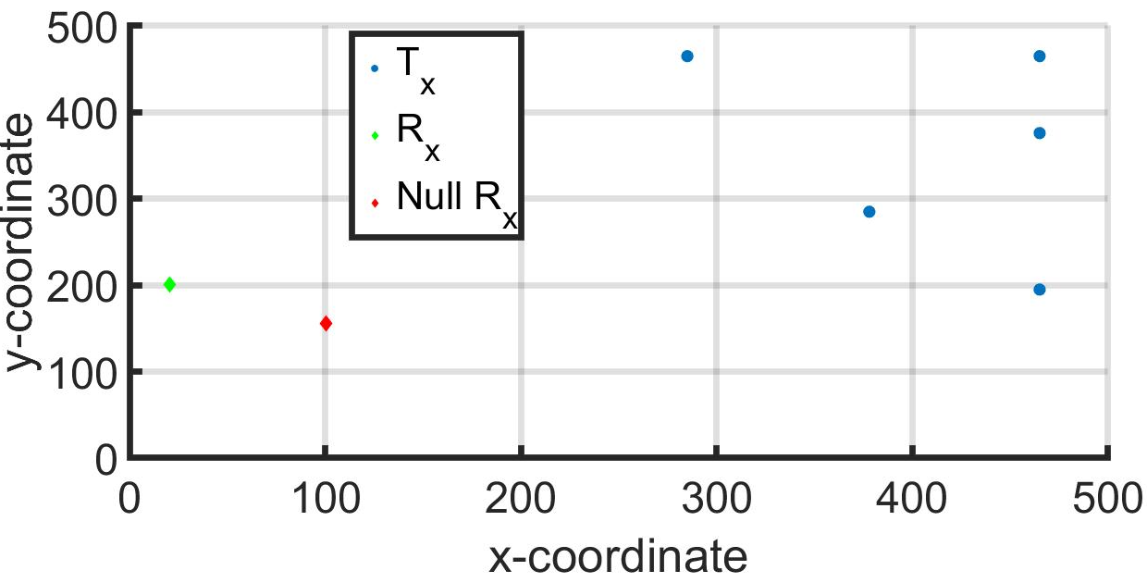
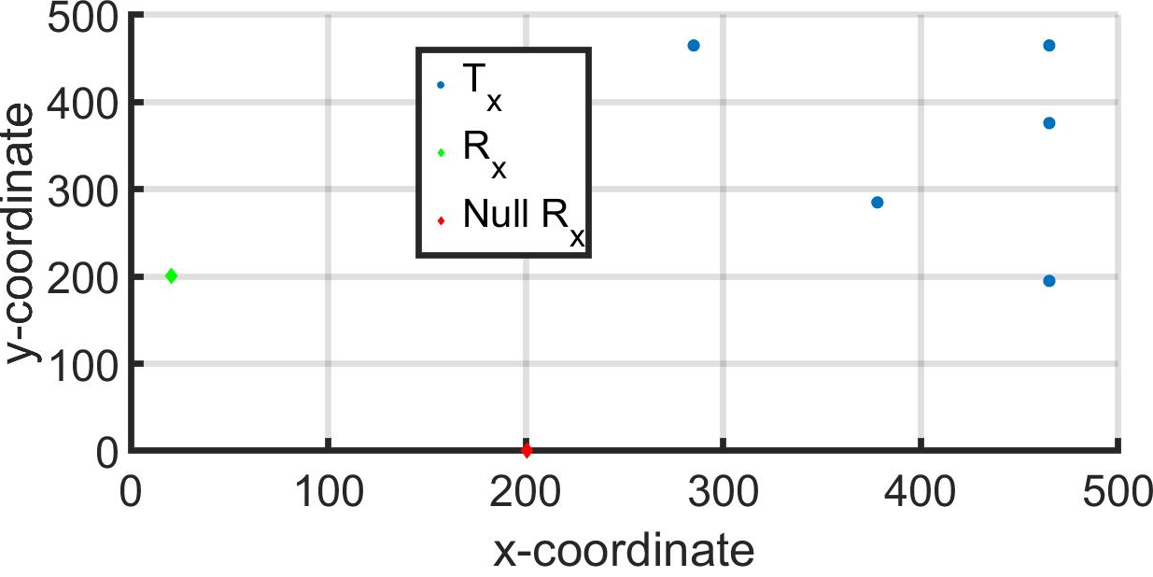
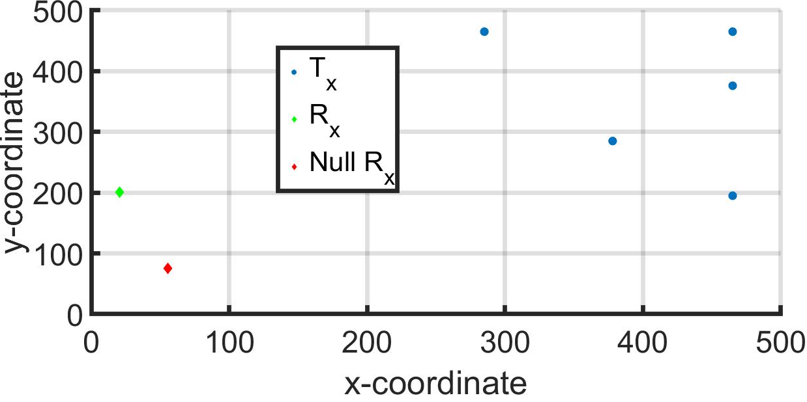
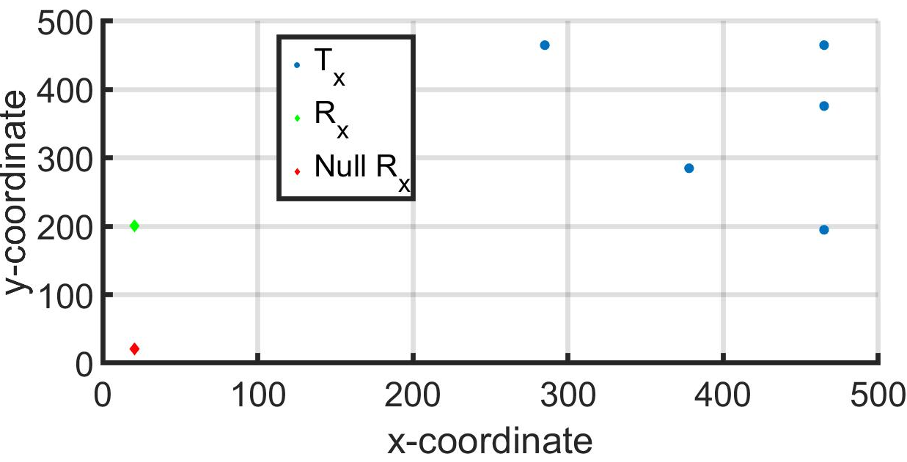
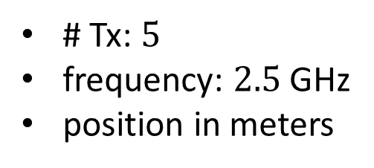
(x,y)-Position of Agents and Receivers
# Tx: $5$
frequency: $2.5$ GHz
position in meters

Slide 3
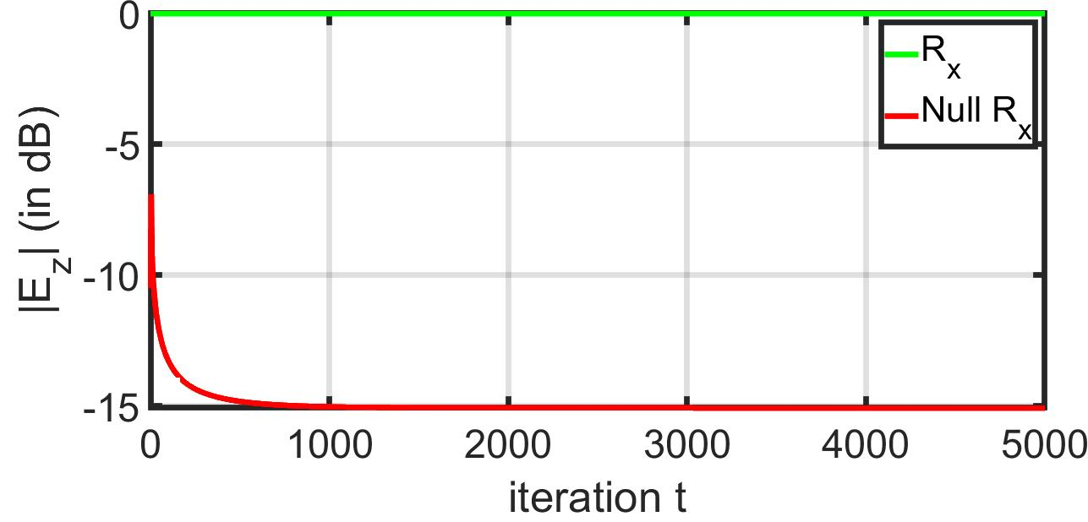
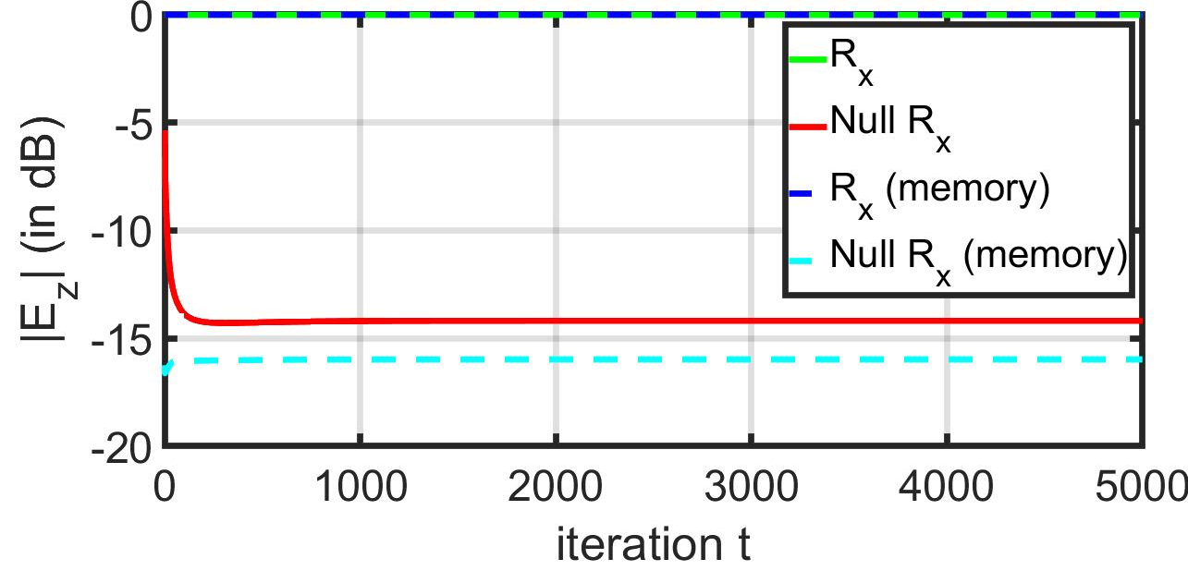
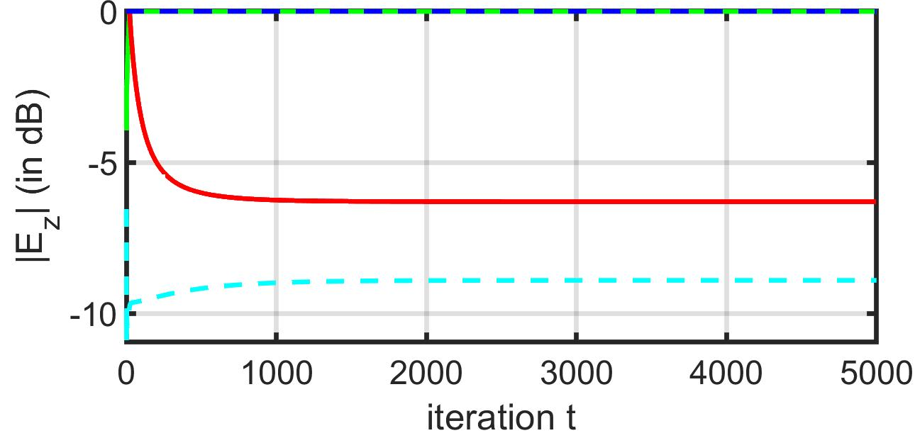
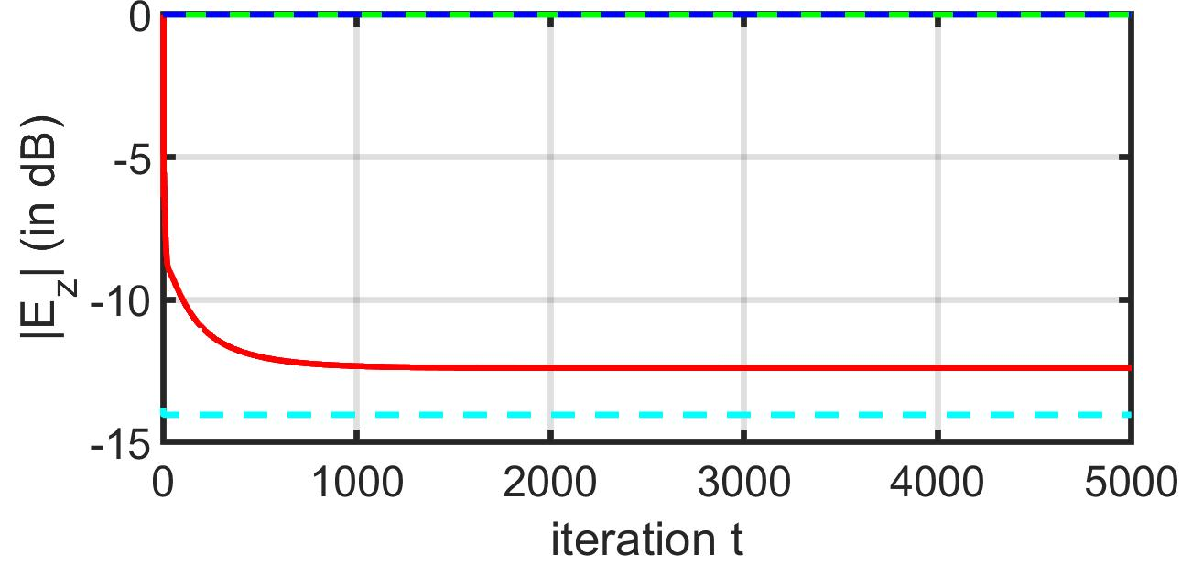
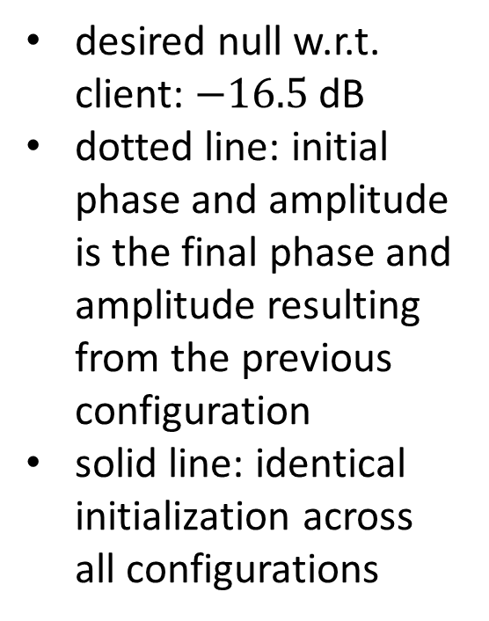
Amplitude Pattern of Electric Field in z-Direction
desired null w.r.t. client: $−16.5$ dB
dotted line: initial phase and amplitude is the final phase and amplitude resulting from the previous configuration
solid line: identical initialization across all configurations

